Slide 1

THE FUTURE OF LANDSLIDE PREDICTION
Data Science To Save Lives
START Hack 2022
Nerds & Nerdbusters
Machine Learning based prediction of landslides

Slide 2







3 different universities, 4 different fields of study – 1 joint mission!
Leopold
Electrotechnical Engineering
Florian
Engineering Science
Elsa
Mechanical Engineering
Benedikt
Business Administration

Slide 3
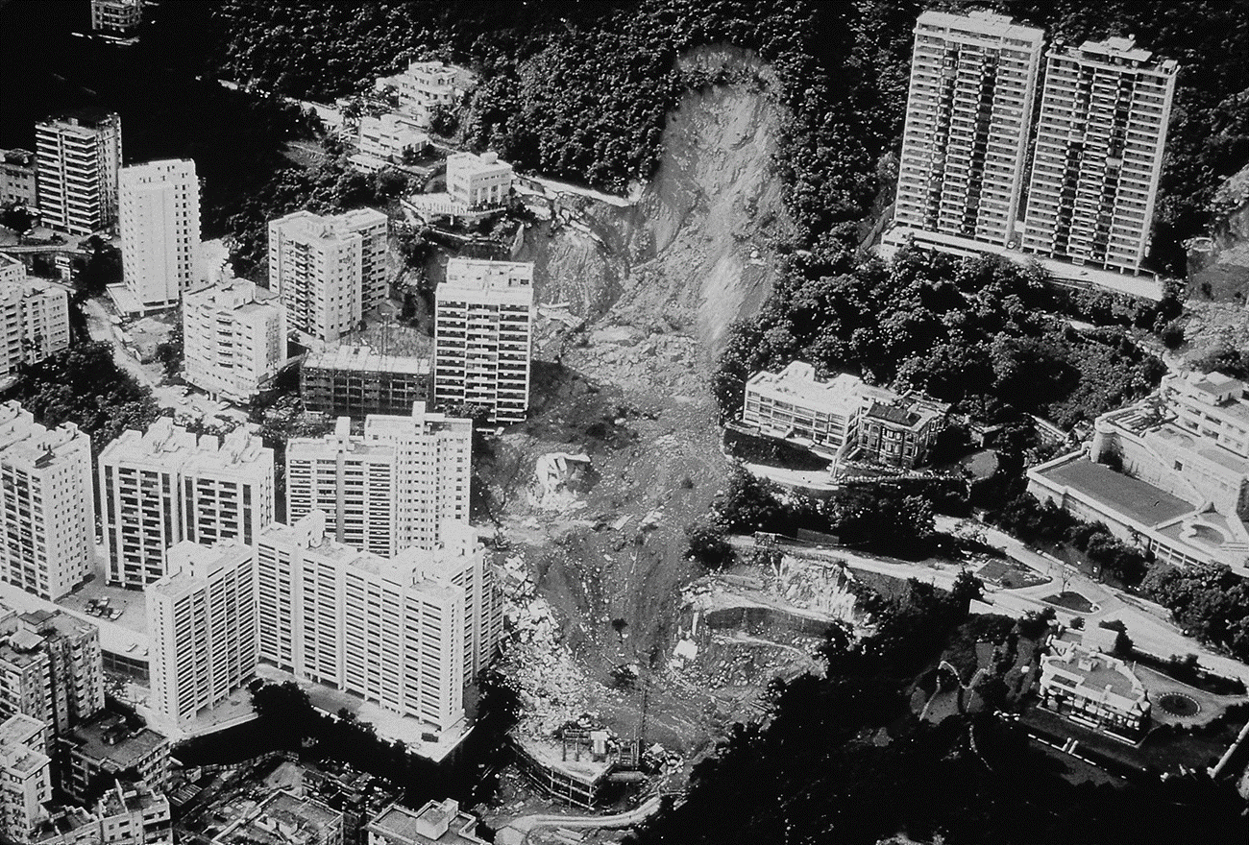




Problem identification
Landslides endangering people and infrastructure
Climate Change leading to extreme weather events increases the danger for further landslides
Population density in rural areas leads to infrastructural dependencies and more people at risk
Lack of efficient data-driven prediction monitoring in current Landslide Warning Systems

Slide 4



Solution: Data-driven landslide prediction model
Data gathering through topological and geological measurements
Training data
Validation data
Test data
Using ensemble of binary classification methods for data analysis
Predictions on future landslides
Real-life measures to minimize the damages

Slide 5
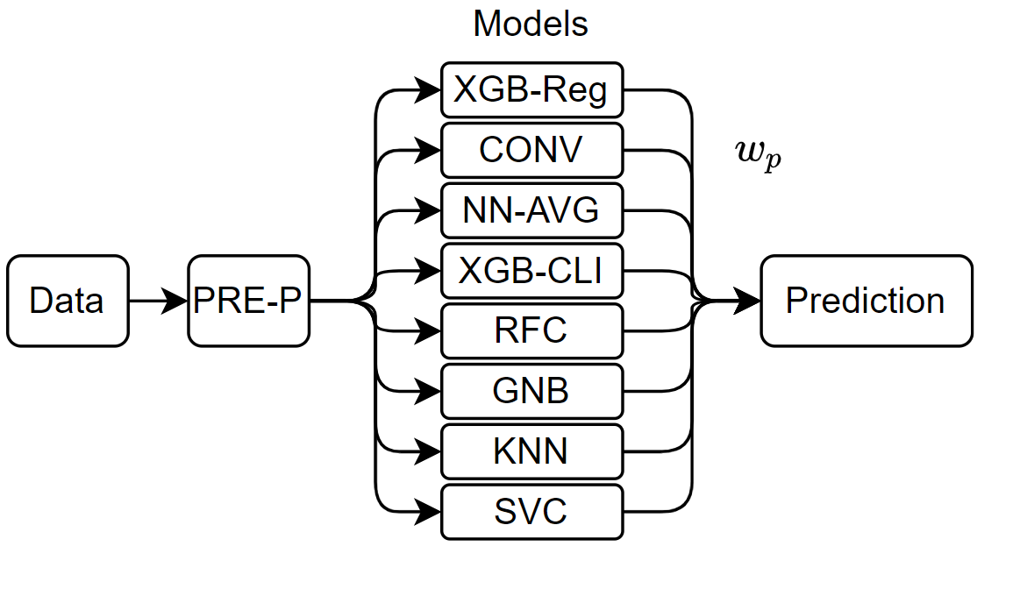
Deep Dive Solution: Ensemble of binary classification methods

Slide 6







Holistic approach: The successful implementation of a Landslide Prediction Model consists of various factors
Integration in existing warning systems
Data collection and measurement
Landslide
Prediction
Model
Updating and
Administration
of model
Collaboration
with community
Definition of SOP in
case of landslide alert
Establishment of
responsible body
SOP = Standard Operating Procedures

Slide 7



Our solution is not only applicable to Hongkong but in various other areas and different use cases
Replicate
1
Using comparable data, our model can be replicated
Develop and Improve
2
Further develop the model by integrating data such as weather and vegetation
Apply and adapt
3
Application of solution on other areas

Slide 8
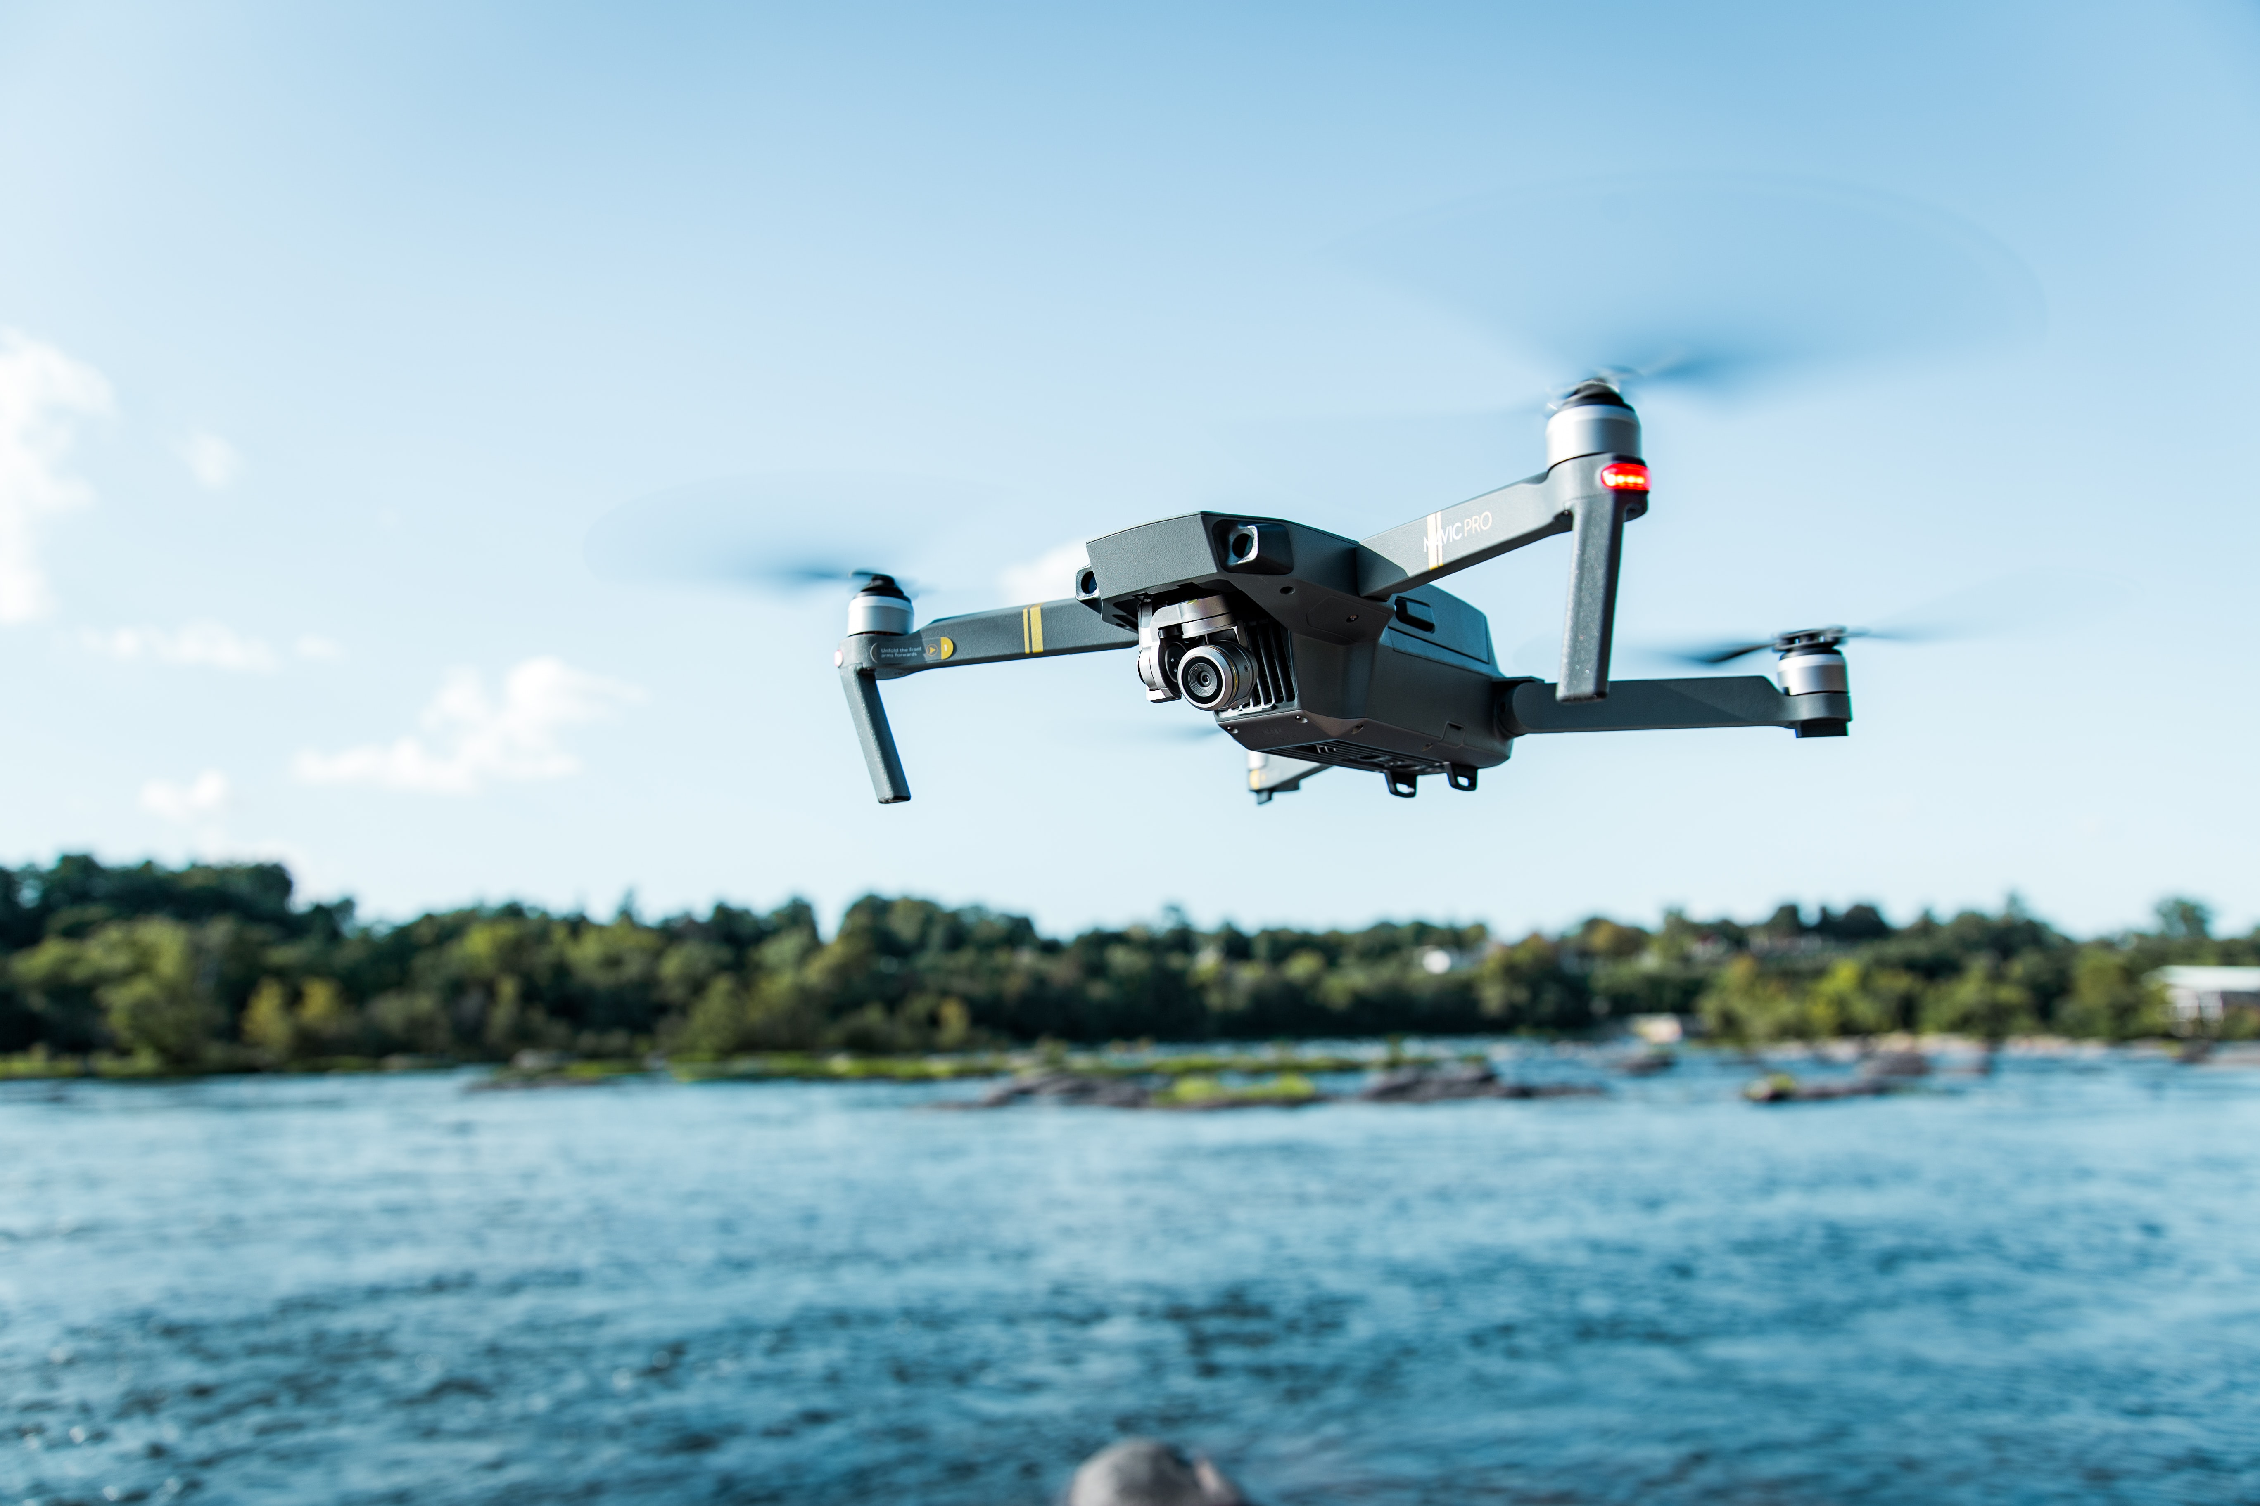





Future potential: Modern technologies can improve data collection and our model’s performance
Modern drone and satellite technology for better topological data
Collaboration with cross industries (e.g., agriculture/ construction) for sharing geological data
AI algorithms to analyse community-taken pictures for early signs of landslides
Robotic technology for drilling to conduct geological measurements
Connecting local prediction models internationally to optimize knowledge sharing

